Slide 1

INSTRUCTIONS FOR CREATING A LANDSCAPE POSTER
FOR THE 2024 ENGINE CAPSTONE SHOWCASE
QUESTIONS?: email pr_team@ece.uw.edu
1. DOWNLOAD (.PPTX) AND VIEW THE EXAMPLE AND BLANK SLIDE TEMPLATES
Open in PowerPoint and navigate them using the slide thumbnails on the left.
2. WE’VE COPIED THE BLANK TEMPLATES TO NEW SLIDES (3)
FOR YOU TO BEGIN CREATING THE POSTER OF YOUR CHOICE.
If you’d like to create different versions of your poster, right click and choose “DUPLICATE SLIDE” in PowerPoint.
3. TO DISPLAY GUIDES: Select VIEW - GUIDES in the PowerPoint top menu bar.
4. WHEN FINISHED, SAVE AS BOTH .PPTX and PDF files
5. IMPORTANT!! DO NOT CHOOSE TO ‘OPEN WITH GOOGLE SLIDES’
Your poster template will not be formatted properly. Download this file first and open/work within PowerPoint.
*PREFERRED FONTS ARE USED IN THIS SAMPLE PRESENTATION: “ENCODE SANS” FOR TITLES AND “OPEN SANS” FOR BODY TEXT –
These can be downloaded and installed on your computer for free here: https://www.washington.edu/brand/graphic-elements/font-download/

Slide 2

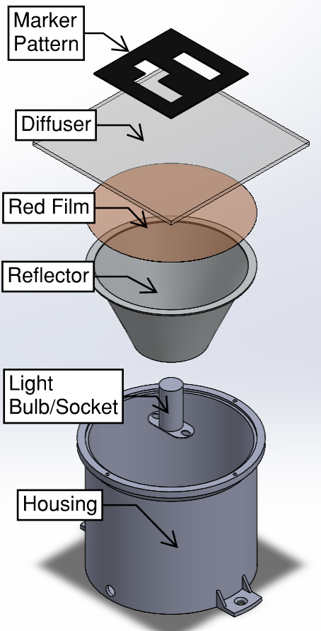
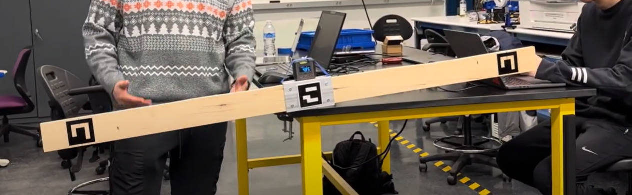
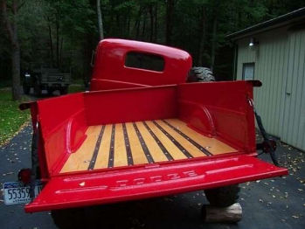
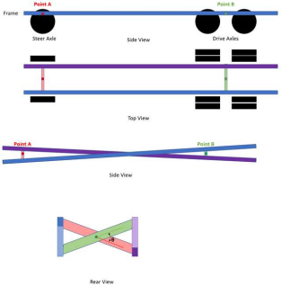
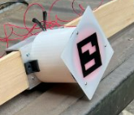
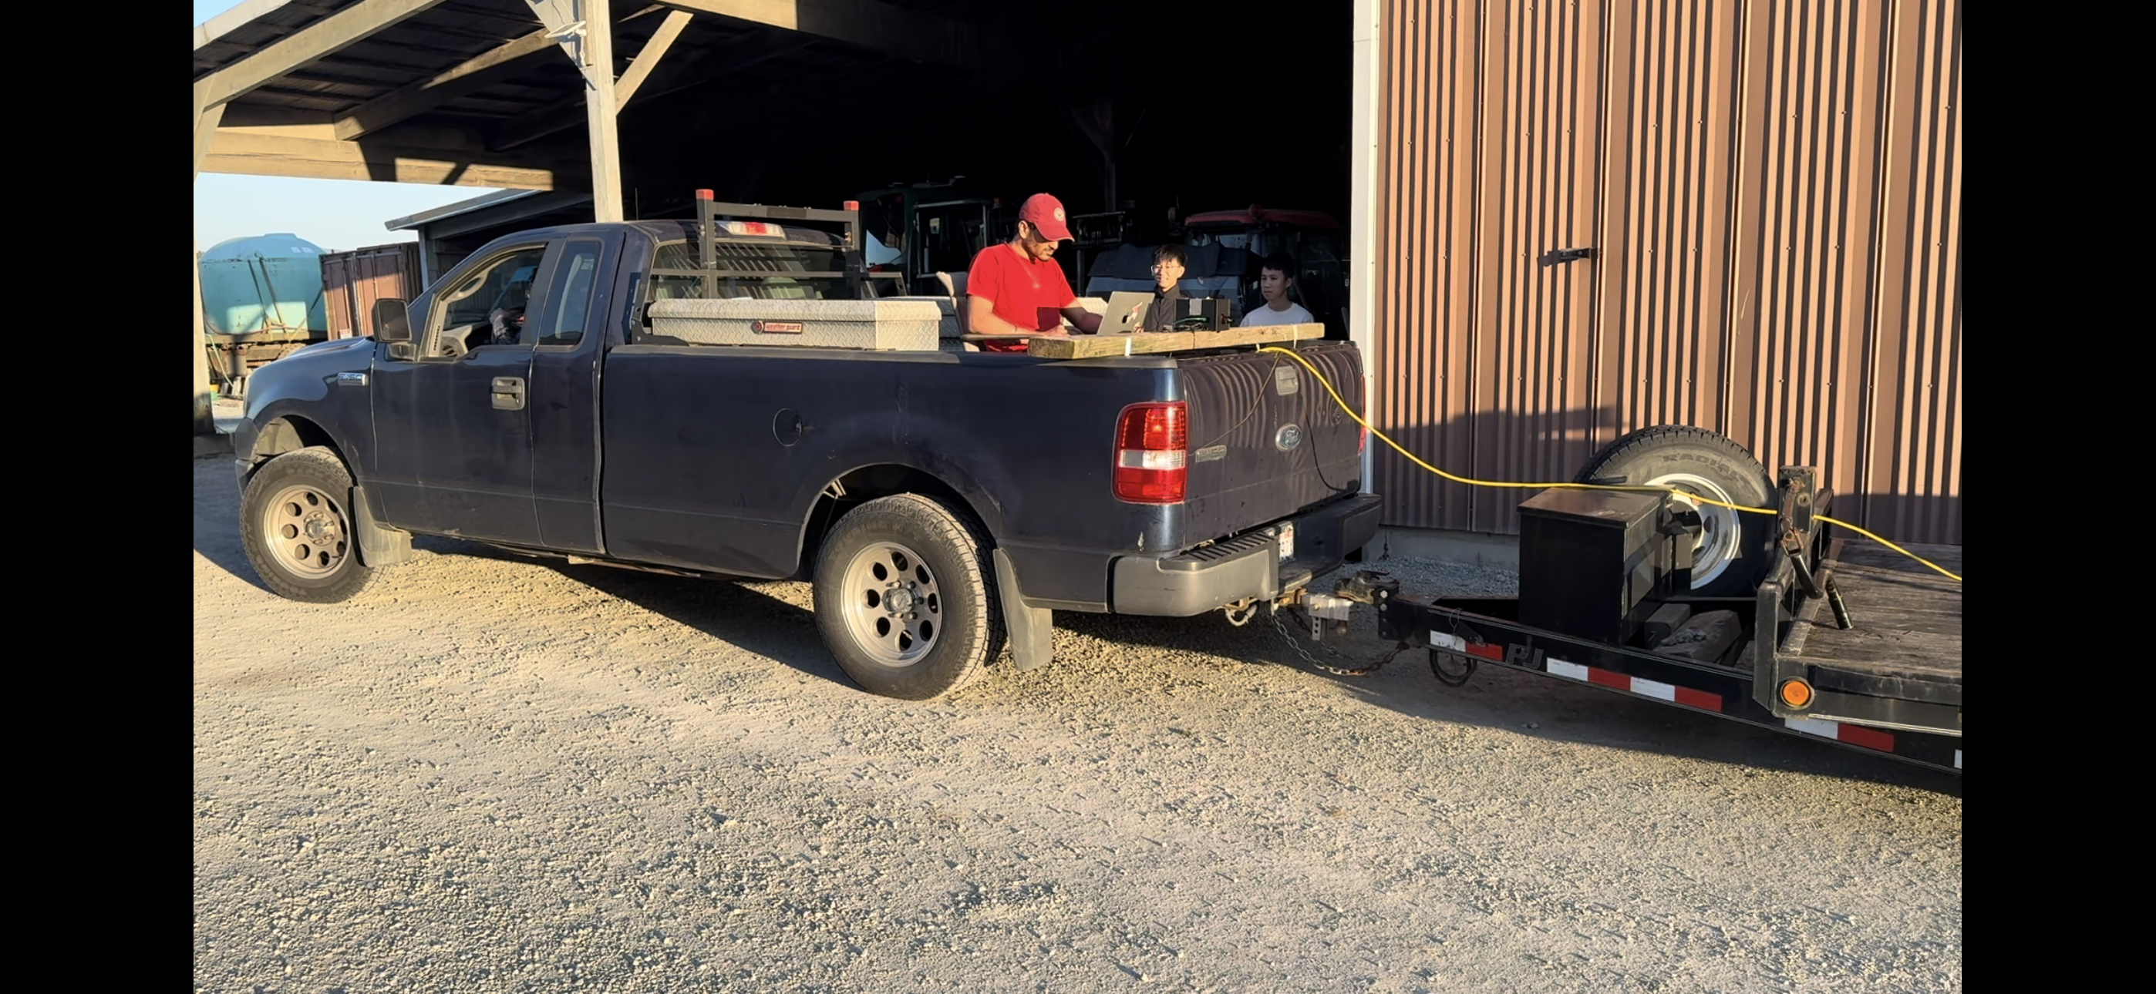
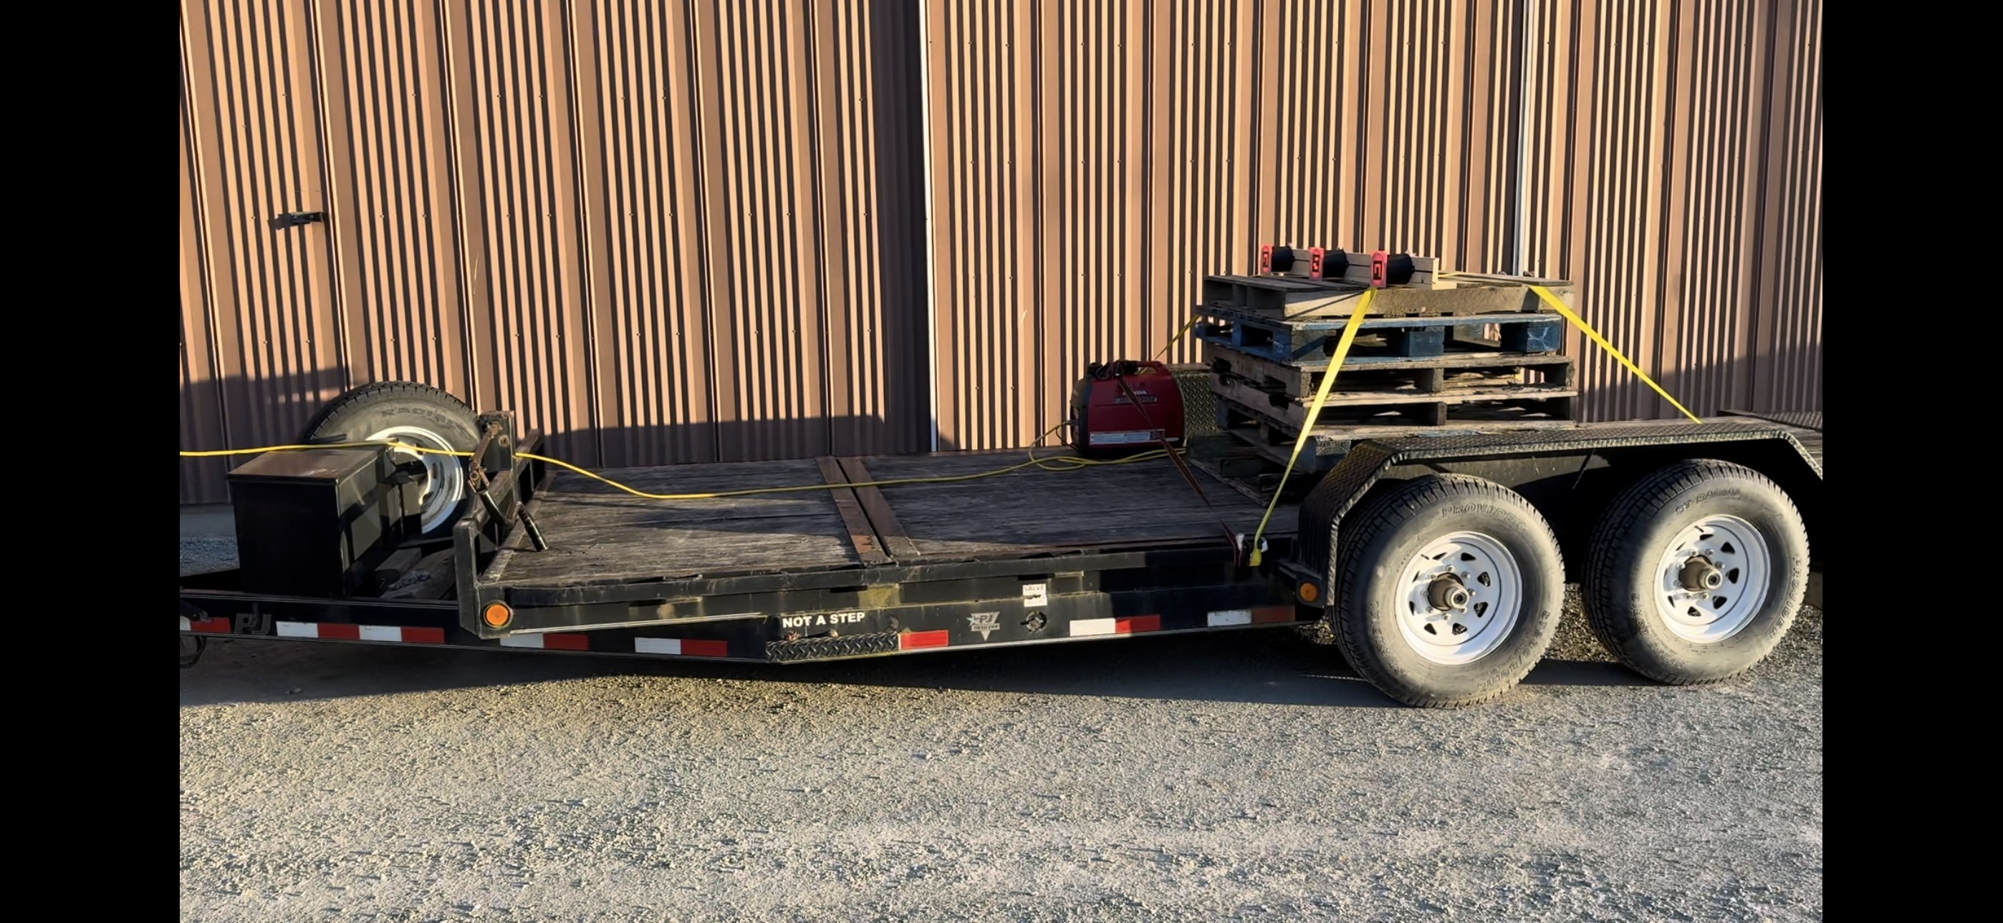
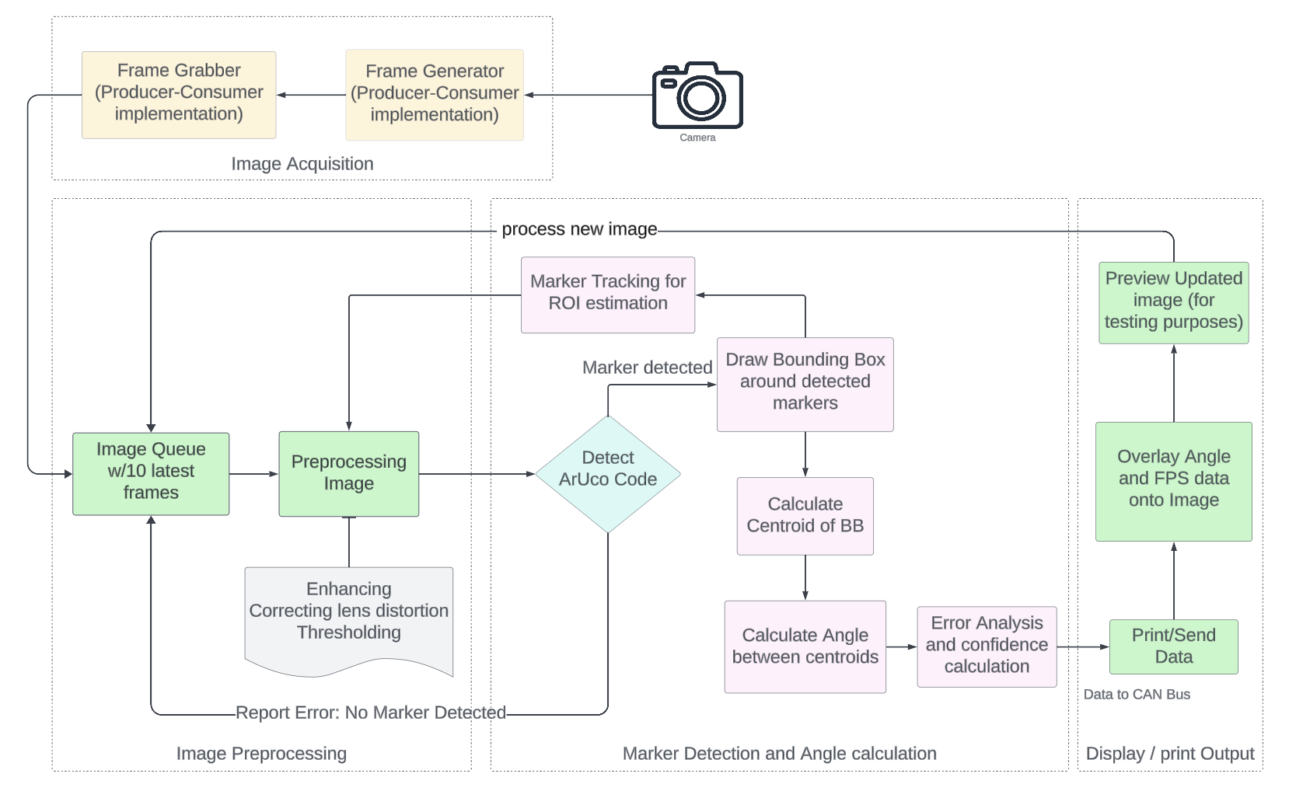
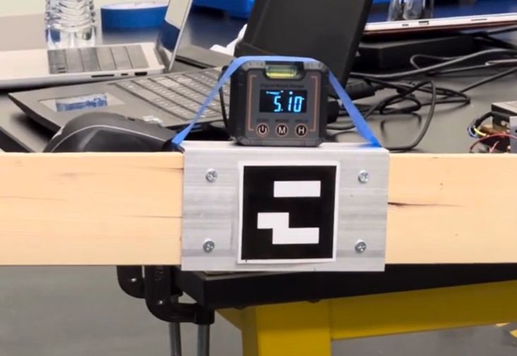
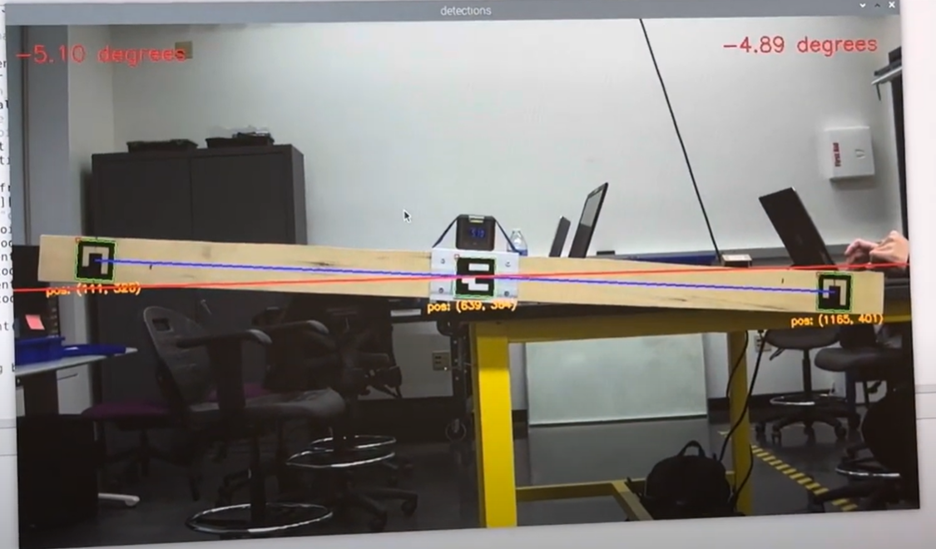
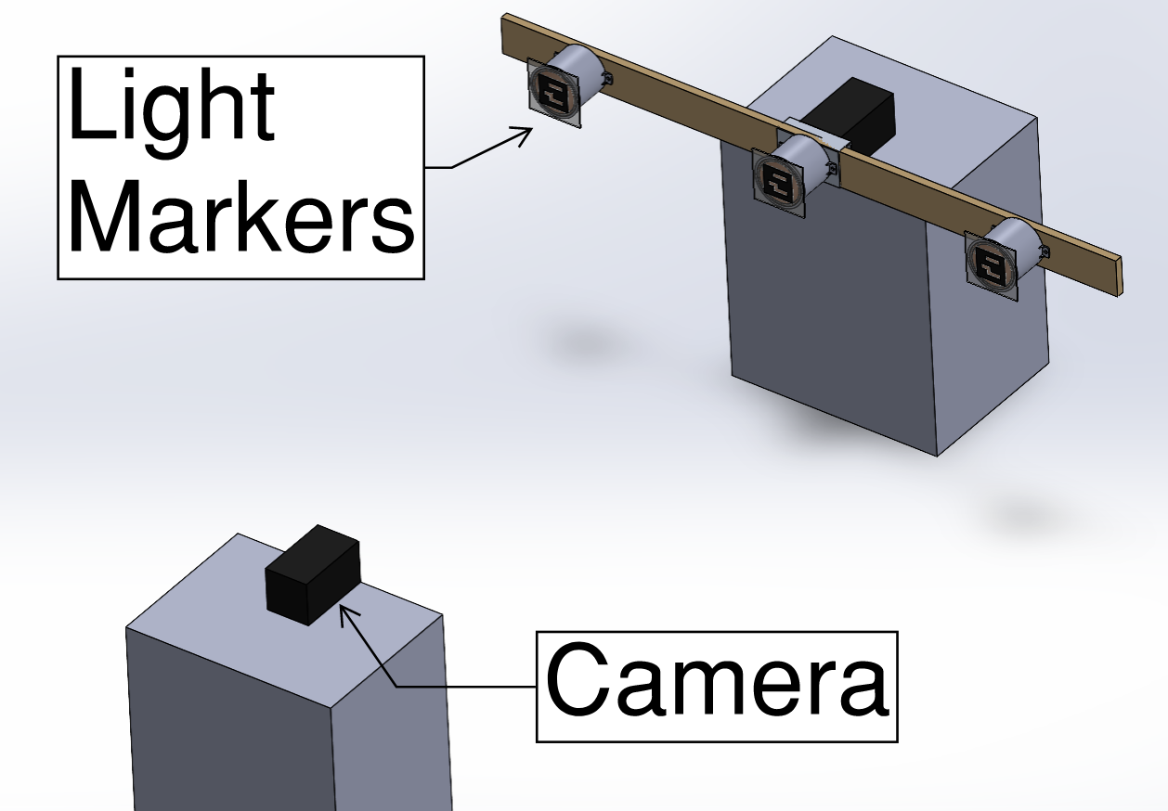
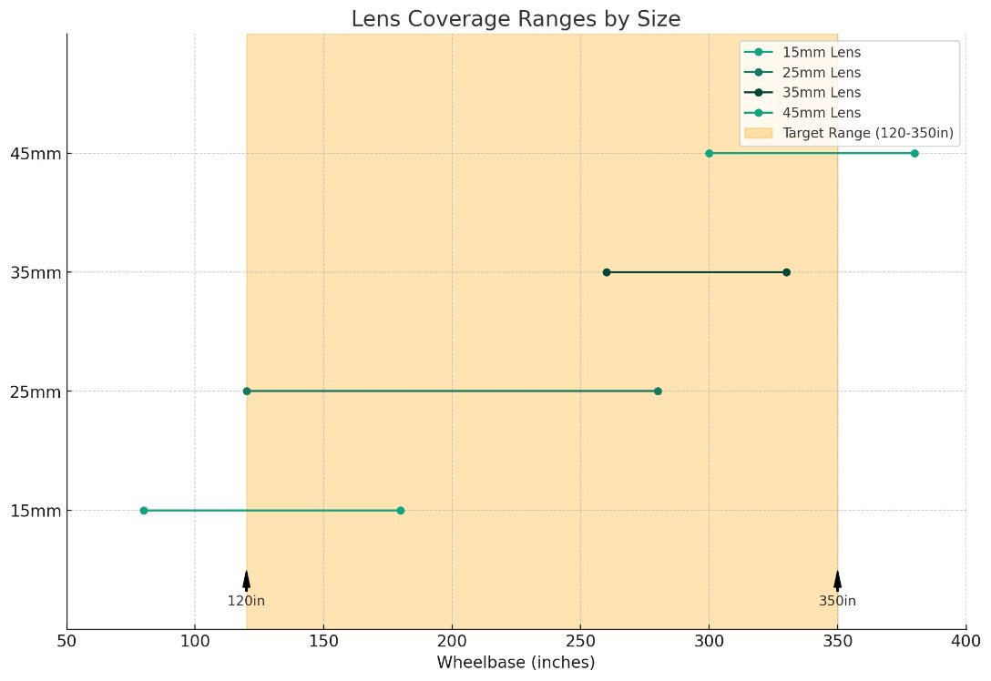
Real-Time "Frame Twist" Measurement Device
STUDENTS: Xinhao Guo, Eric Lee, Ian Li, Jonathan Murguia, Sanjay Varghese
Introduction
Light Markers
Testing
PACCAR Technical Center (PTC) is looking for a simple method to measure tractor/trailer frame twist which is needed for the calibration of vehicle dynamic simulation models.
An unexplored camera-based approach for measuring frame twist has been proposed by PTC.
A light source is used to illuminate the markers patterns to allow easy detection independent of environment.
Red film is used to turn the light red which paired with a red-light filter, filters out all but red light.
ArUco codes are used for the marker patterns for they are simper to detect at a distance.
In the lab, we used a stepper motor to move our markers by prescribed angular displacements.
We did this to test the device's accuracy by comparing the recorded angles to the actual angle we set the markers to.
Figure 7: Lab test setup
In the field, we mounted our system to a truck and trailer and then had them drive over obstacles.
We did this to test the effects of vibrations on our data accuracy.
Figure 4: Assembled light marker
Figure 5: CAD model of light marker
Figure 1: Truck twisting
Figure 2: Frame twist diagram
Algorithm Overview
Objective
Develop a device capable of measuring ±20° in angular deflection with a resolution of ±0.2°.
The device should broadcast the data over the CAN bus interface with a frame rate >=60Hz.
CAN data should include the angular measurements, accuracy of the measurements, and the confidence of the accuracy
The device must be capable of calibration at different wheelbase lengths
Figure 8: Field test setup
Our tests measured relative angular displacements, not actual frame twist.
Results
In our lab tests, we achieved the target accuracy and range of motion.
We tested at different wheelbase lengths and obtained similar results.
Due to a hardware issue, we could only attain a max frame rate of 45Hz.
In our field tests, we learned how outside light can prevent our markers from expelling only red light.
In the interest of time, we cut CAN integration and confidence reporting out of our scope.
Implementation
A camera-based approach where a camera records markers, then uses computer vision to identify the illuminated markers and calculate the angle based on the vertical displacements of the markers.
These components would be in the undercarriage. The camera would be placed at the front end of the truck frame looking towards the back. The light markers would be placed at the back end of the truck frame.
Figure 9: Test setup reference measurement
Figure 6: Block diagram of camera detection
Image Acquisition:
Utilizes a Frame Grabber to capture images.
Image Queue and Preprocessing:
Processes an input queue of 10 frames.
Marker Detection & Angle Calculation:
Estimates the Region of Interest (ROI) and performs warping for ROI tracking.
Detects markers, draws bounding boxes (BB), calculates the center of the BB, and computes the angle between centroids.
Display/Print Output:
Updates and previews the image with information such as angle and frames per second (FPS) data.
Figure 10: Camera measurement during testing of first prototype
Future Work
Work out hardware issues to obtain a higher frame rate.
Broadcast our data over CAN.
Develop a method of incorporating confidence into our readings.
Figure 3: CAD model of prototype test setup
Figure 11: Graph showing ideal lens for wheelbase ranges
ADVISERS: Daniel Moreland, Shreyas Chaudhari, John Reece, Kavya Balasubramanian
SPONSOR: PACCAR
Notes:
Horizontal Version

